Slide 1
Finch Robots Workshop
By Nora Hixson and Jonah Cook

Slide 2

What is a Finch
A finch is a little robot that we can program to do all sorts of things, including moving, singing, lighting up, and using sensors.

Slide 3
We will program them using Python

Slide 4
Here is an example of a for loop in Python

Slide 5
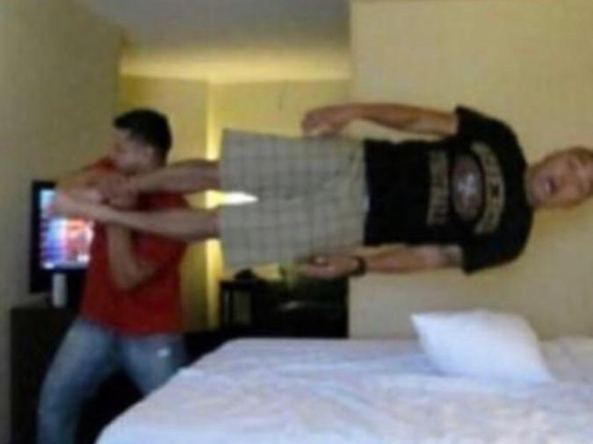
Insert commented piece of Python please Jonah

Slide 6
Now that you know a little bit of Python let’s apply it to the Finch

Slide 7
Finch API
https://learn.birdbraintechnologies.com/finch/python/?robot=finch&software=python&moduleslide=&pg=library&r=&&moduleslide2=
All the different Finch commands

Slide 8
Starting to Program Step 1 Connect the Finch
Take the USB from your Finch and plug it in to your computer. Open you Bluebird Connector, and turn on your Finch. After you turn on you Finch you will see it flash letters on it’s tail light. Those are it’s initial. Look and the Bluebird connector and select the Finch with the same initials.

Slide 9
Step 2 open your Python
Open VS Code create a new finch object!
Ex
bird = Finch()

Slide 10
Have Fun!
Finally use what you learned to make you finch do whatever you want!
Ideas
Have Finch play a Song
Have Finch run into a wall and turn around
Make the Finch sad when you shake it
Make the Finch dance

Slide 11
How do I start?
You should already have your finch connected to your computer at this point. Now type
myFinch = Finch()
This tells your program that you want “myFinch” to be an object representing the connected finch. This means that you can now use “myFinch to talk to your finch and give it instructions.
This should always be the first line of code you write. You will not be able to program your finch otherwise.

Slide 12
Basic Movement
There are a few commands you can use to control your finch. One of them is
myFinch.setMove(direction, speed, distance)
which moves your finch forward or backward for a set distance at a set speed (PSA: you don’t actually type “direction, speed, distance” in the parentheses. These are called “parameters” and they are meant to be replaced by the values you want). The “direction” parameter can be either “F” or “B”, the speed can be anything from 0-100, and the distance can be any distance in centimeters.

Slide 13
Basic Movement (cont)
For example:
myFinch.setMove(“F”, 100, 50)
means that the finch will move forward (“F”) for 100 centimeters (100) at half speed (50). You can mess around with this and see what you can make your finch do!
(remember, you can replace “F” with “B” to make your finch move backwards)

Slide 14
More Movement
We have some other movement commands. One of these is
myFinch.setTurn(direction, angle, speed)
which turns the finch a certain amount. The “direction” parameter can be either “R” or “L” to make it turn right or left. The “angle” parameter will turn the finch that many degrees. The “speed” parameter can be from 0-100 and dictates how fast the finch will turn.
myFinch.setTurn(“R”, 90, 100)
tells the finch to turn right (“R”) for 90 degrees (90) at full speed (100).

Slide 15
More Movement
We have some more movement options. These are
myFinch.setMotors(leftSpeed, rightSpeed) and myFinch.stop()
setMotors lets you independently control the individual wheels of the finch. leftSpeed and rightSpeed can both be between -100 and 100 (a positive number will rotate the wheel forwards, and a negative number will rotate the wheel backwards). Setting a motor speed to 0 will simply turn off the motor. Alternatively, you could type stop(), a method with no parameters, to set both motor speeds to 0.

Slide 16
Crash Course in Python Syntax
All the movement commands you have used to far are called “methods”. Methods are pieces of code stored elsewhere in the program, and when you say the method name, like stop(), it runs the code stored in the method.
Parameters are pieces of information that you give to methods to help them run. If you simply called “setMove()” with no parameters in the parentheses, the program would have no idea how fast you want the motors to go, and it would cause an error. This is why we put parameters inside the parentheses, to tell the function exactly what we want it to do.
(parameters must be separated by commas. failure to do so will result in your program crashing)

Slide 17
Objects and Dots
Earlier, we created the finch object and called it “myFinch”. This means that, if we want to give instructions to the finch or call any of its methods, we have to do it as such:
myFinch.setMove(“B”, 10, 50)
myFinch.setTurn(“R”, 180, 75)

Slide 18
If Statements
An if statement is basically you telling the code “hey, if this is true, then do this”. If statements are written as such:
if (condition):
do something
What this will do is it will do whatever is in the place of “do something” if “condition” evaluates to true. You need everything in the place of “do something” to be indented under the if statement or it will not work properly. If the condition evaluates to false, the code entirely skips the if statement and whatever code it contains.

Slide 19
If-Else Statements
An “else” statement can be used to run code if and only if the condition in an if statement evaluates to false. For example, in the following code segment, “do something” would run if condition was true, and “do something else” would run if condition was false.
if (condition):
do something
else:
do something else

Slide 20
While Statements
While statements are similar to if statements in that they evaluate a condition, and if the condition is true, it runs the code. However, while statements will continuously run the code inside the statement until the condition evaluates to false.
while (condition):
do something
Whatever is in the place of “do something” will repeat itself until “condition” becomes false, at which point whatever is after the while loop will run.

Slide 21
Conditions
There are a lot of expressions in python that evaluate to “true” or “false” for use in if/else/while statements, but we will focus on one type: expressions returned by a finch method. Some methods available to us can return a true or false value, like
myFinch.isShaking()
which returns “true” if the finch is shaking and “false” otherwise.

Slide 22
Displaying Colors
There are lights on the finch that we can activate with our code! One method that lets us do so is
myFinch.setBeak(redIntensity, greenIntensity, blueIntensity)
which sets the LED in the finch’s beak to glow with the intensities you specify. Each intensity specifies how much of that color will be present when the LED glows, and the intensities can be anywhere from 0-100. Setting all 3 intensities to 0, by saying “myFinch.setBeak(0, 0, 0)” turns the LED off.

Slide 23
Displaying Colors (cont)
Another method that we can use is
myFinch.setTail(port, redIntensity, greenIntensity, blueIntensity)
which sets certain lights on the finch’s tail to glow at certain intensities. This functions identically to the setBeak method except for the “port” parameter, which specifies which light will glow. The possible ports are 1, 2, 3, 4, and “all”, which will apply the intensities to all four lights on the tail.

Slide 24
Color Examples
myFinch.setBeak(100, 0, 100)
causes the LED in the beak to glow bright purple, as we have turned the red and blue up to the maximum brightness, which combine to form purple.
myFinch.setTail(“all”, 50, 50, 50)
causes all the LEDs in the tail to glow at medium white intensity, since the port is “all” and the color is a mix of red, green, and blue (the primary colors that combine to form white).

Slide 25
A Sample Finch Program
myFinch = Finch()
while True:
if (myFinch.isShaking()):
myFinch.setBeak(0, 0, 100)
else:
myFinch.setBeak(0, 100, 0)

Slide 26
Program Explanation
The “while True” line (the first line in the program) means that whatever code follows that is more indented than itself will run until the program ends or the finch disconnects, since the condition “True” will always evaluate to true.
The “if (myFinch.isShaking()):” line asks your finch if it is shaking, and if it returns “true”, runs whatever code we have in the if statement. In this case, it is code that makes the beak glow red.
The “else:” line will run if the condition of its matching if statement turns out to be false. In this case, it means that when the finch is not shaking, its beak will glow green.

Slide 27
The “for” loop
A “for loop” is something we can use to execute code several times. Say, for example, we wanted to have the finch turn in at a right angle four times but didn’t want to type out repetitive code. We could do
for x in range(4):
myFinch.setTurn(“R”, 90, 100)
to easily draw a square without repeating our code. There is definitely more to learn about for loops, but in this case, all you need to know is that the number inside the parentheses dictates how many times the code inside the loop will run. We can increase or decrease it as we wish.

Slide 28
Challenge: Make your Finch dance!
Time to put those python skills into practice! Using the python you have learned so far, make your finch dance or move in some neat way. It could run forever or dance for just a bit then stop, it doesn’t matter. This is your chance to be creative and test yourself on what you have learned so far! For bonus points, add a light sequence to the dance. (don’t worry, I won’t be grading this)
Hints:
If you want your finch to move endlessly, put all of your movement code inside a “while True:”
Don’t forget to indent! Indentation is how you tell your program which parts are supposed to be in certain loops or statements.
Remember, some parameters for functions like setMove must be in quotes, since they are not numbers. If you want your finch to move, then the “direction” parameter must be either “F” or “B”. It cannot be F, f, B, or b, since they are not encased in quotes.

Slide 29
Challenge: Make your Finch mad!
This one might be a bit harder to do. Have your Finch constantly check to see if something specific is happening to it, and if it is, have it react negatively in some way. For example, if your Finch is being shaken, have it play a sound and light up red, and if it is not being shaken, have it return to normal.
Hints:
If you want your finch to loop endlessly to check a certain condition, put your code inside a “while True:”
Don’t forget to indent! Indentation is how you tell your program which parts are supposed to be in certain loops or statements.
The argument for the “setTail”’s port method can be “all” to make all the tail lights go on

Slide 30
Finch Documentation
This site will be your best friend during this workshop. It lists all the methods available to you and your finch, and explains what each of them do and what parameters they require.
https://learn.birdbraintechnologies.com/finch/python/?robot=finch&software=python&moduleslide=&pg=library&r=&&moduleslide2=
If you need any help with your program, ask Jonah or Nora for assistance! We can help find out what is going wrong and get your finch doing what you want it to.

